Slide 1


Latrine Use: Measurement, Indicators, and Behavioral Drivers
Zuwena Plata
Pavani Ram
Nidhi Pasi

Slide 2
A simplified theory of change
Knowledge
Attitudes
Behavior

Slide 3
A less simplified theory of change
Social Norms
Knowledge
Attitudes
Behavior
Habits

Slide 4
A less simplified theory of change
Social Norms
Intervention B
Knowledge
Attitudes
Behavior
Habits
Intervention A

Slide 5
Knowledge
Typical focus likely on the health benefits of latrine use
Data collection method: Questionnaires
For handwashing behavior (and many other socially desirable behaviors), knowing that it is important to wash hands does not translate to use

Slide 6
Attitudes
Typical focus on benefits and barriers to latrine use
Data collection method: while often reliant on questionnaires, may be better addressed using qualitative methods

Slide 7
Social Norms
Simply (very simply): our expectations of ourselves and others, and their expectations of us
Need for validated measures of social norms for sanitation
  How do norms change from before to after a sanitation intervention is applied?
  How sustained are norms changes months or years after a sanitation intervention?
University at Buffalo (R. Muldoon) drafted a set of proposed questions to measure social norms
  Latrine use
  Latrine maintenance

Slide 8
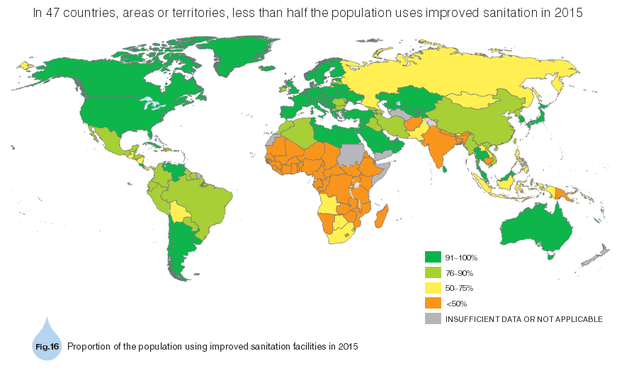
Behavior?
UNICEF and WHO, 2015

Slide 9
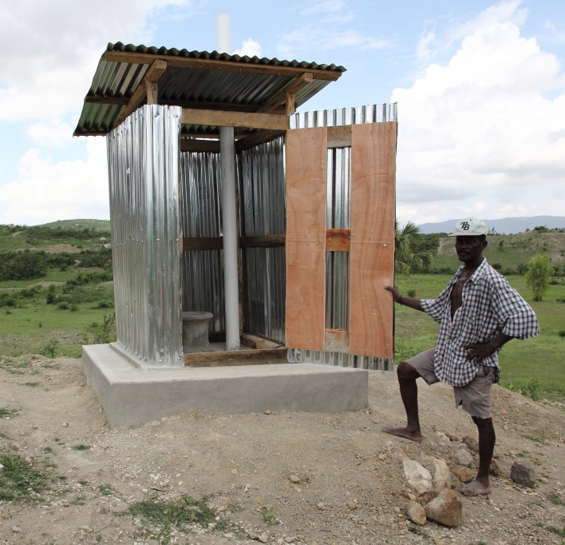
Behavior: Latrine Use
JMP definition reflects access, not use
Access ≠ Use
How is latrine use defined?
  Use of latrine as primary defecation site
  May also include:
    Urination
    Anal cleansing
    Washing clothes
    Post-defecation bathing
Here, the focus is on use of the latrine for defecation
Photo: worldconcern.org

Slide 10
Measuring Use
  Direct measures
    Questionnaires
    Structured observation
  Proxy measures
    Rapid observation
    Sensors
Notes:
-Self report is the most common method of data collection and information is gathered from questionnaires or interviews done on site. It can be used to collect data on frequency of latrine use, sites of defecation, latrine use habits of family members and more
-Sensors: much newer method for measuring latrine use and used less frequently. The passive latrine use monitor (PLUM) is an example of this. The sensors are used in combination with interpretation algorithms to identify instances of use, however, the sensors only detect entry and exit and therefore cannot distinguish between reasons for use (the researcher needs to make that distinction when creating the algorithm)

Slide 11
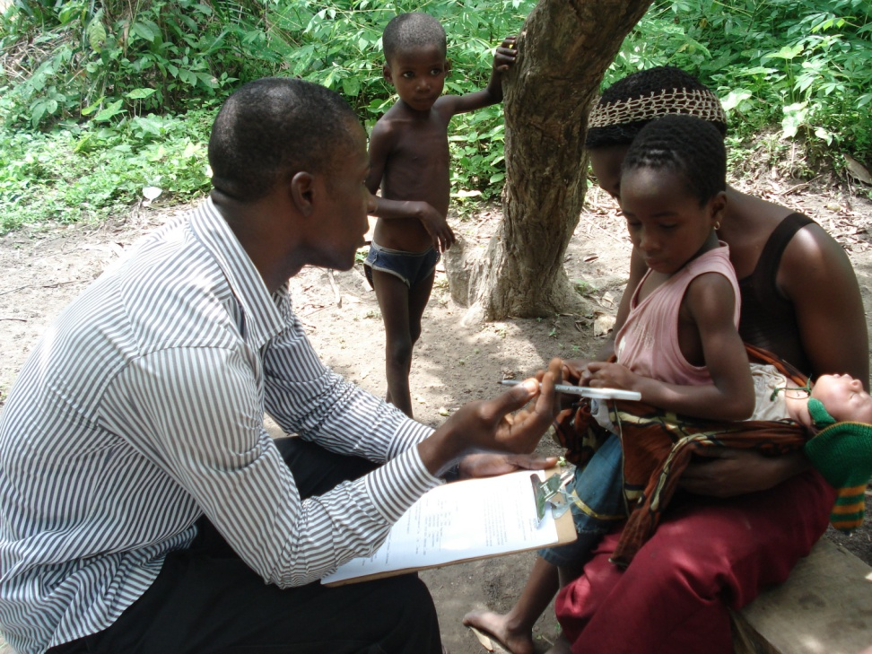
Measuring Use: Questionnaires
Photos: ANAM City Blog

Slide 12
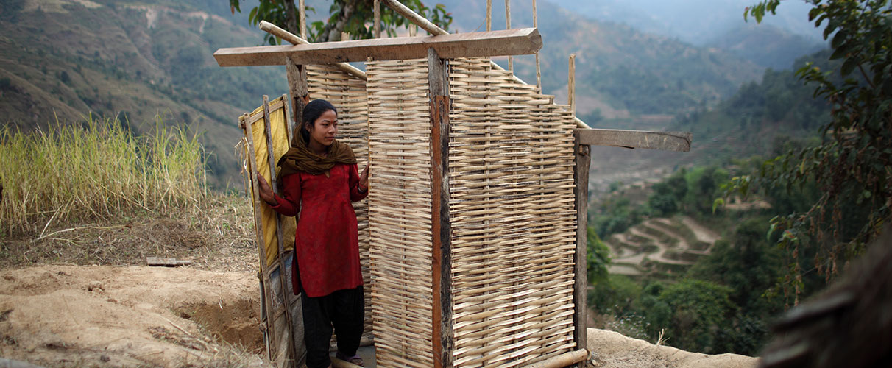
Measuring Use: Direct Observation

Slide 13
Measuring Use: Rapid Observation
Inspection of latrines and surrounding areas for physical signs of use
  Water on latrine floor
  Visible feces in latrine (floor or toilet pan)
  Presence of flies or odor
  Worn path to the latrine

Slide 14
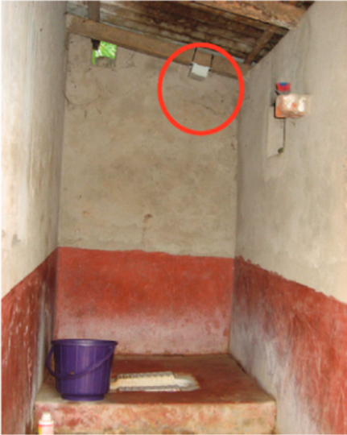
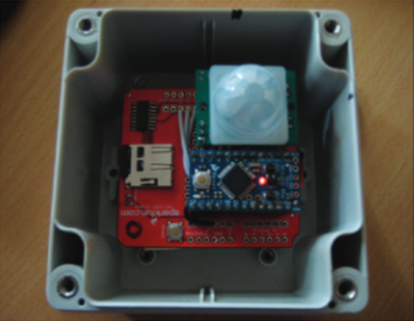
Measuring Use: Sensors
Photos: Clasen et al., 2012

Slide 15
Sample Indicators
  proportion of households with at least one member who exclusively uses a latrine
  proportion of households or individuals reporting safe sanitation locations as most common sites of disposal of child feces
  Note: Specific indicators are largely inconsistent in the literature

Slide 16
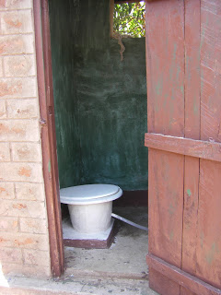
Motivators
Convenience
Cleanliness
Privacy
Safety
Health
Photo: MSABI.org

Slide 17
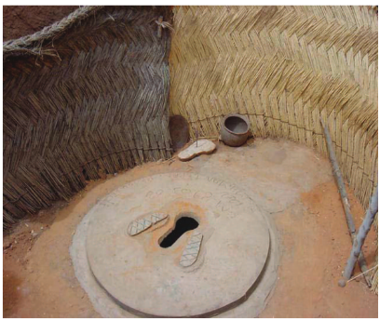
Motivators: Convenience
Photo: Diallo et al., 2007
Notes:
Convenience: closeness to the home reduces time spent walking to find a suitable open defecation site especially at night; especially important when considering families with the elderly, disabled, ill or young children (image is of rural Zinder, Niger – proximity and easy access)

Slide 18
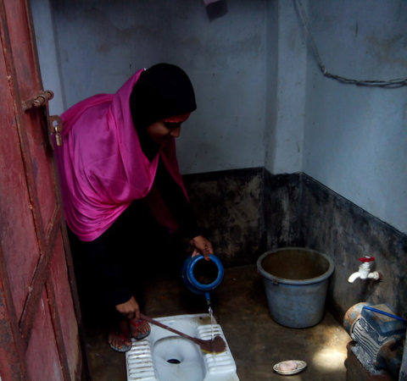
Motivators: Cleanliness
Physical environment
Users avoid exposure to elements
Photo: rsr.Akvo.org
Notes:
Cleanliness: as a result of convenience because there is less exposure to the elements (dirt, rain, mud). Additionally, the physical environment is cleaner leading to fewer flies, maggots and odors

Slide 19
Motivators: Privacy & Safety
Being seen defecating in the open considered embarrassing
Latrines keep women from being exposed while urinating or defecating
Protection from being seen considered a positive for reducing sexual assault by men

Slide 20
Motivators: Health
Mentioned in several studies as a benefit to use
However, often not the primary motivator
43% of individuals in two villages in rural north India did not consider latrine use important for child health (1 village practiced OD and the other did not)
Notes:
Three years post TSC intervention….so health didn’t really make much of a difference in this population.
Health was mentioned in some of the studies but when it was mentioned, it was rarely the primary reason for latrine use.
Comfort and family prestige were also factors that motivated latrine use however they were mentioned less frequently than the other motivators.
-comfort with using toilets in urban areas and much more comfortable if someone has diarrhea
-Fon Royal class in Benin (people aspire to be like them aka using covered pits in discrete areas); a new bride in India (Orissa in particular), seen defecating in the open can lower the family’s status

Slide 21
Barriers
Inconvenient/Uncomfortable
Dirty /Unhealthy
Latrine pit too small
Lack of privacy
Cost

Slide 22
Barriers: Inconvenient/Uncomfortable
Distance from fields to latrines
Agricultural workers are comfortable with the fields
Dislike enclosed nature of latrine superstructure

Slide 23
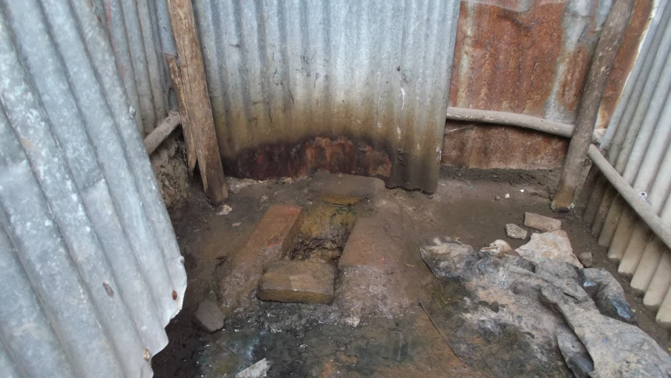
Barriers: Dirty/Unhealthy
Photo: Wikimedia.org
Notes:
Dirty: requires a great deal of work to keep clean and when not maintained can encourage the presence of flied and odor; along with this latrines were considered unhealthy by Ugandan women (risk of catching STI)

Slide 24
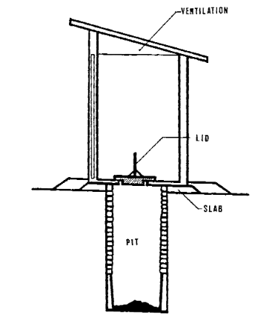
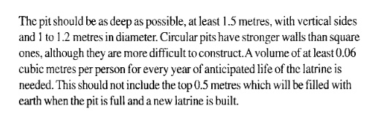
Barriers: Pit Size
Photo: WHO

Slide 25
Barriers: Lack of Privacy
Generally assumed among community members that people who go to the latrine are going to defecate
Thus, being seen when going to or coming from the latrine is embarrassing (especially, with shared facilities)
Notes:
in Zambia seeing someone walk to the latrine is akin to seeing them naked

Slide 26
Barriers: Cost
Costly to build an individual household latrine
In contexts of paid shared facilities, men may only use a latrine to defecate while women use the to urinate as well
Subscription fees for shared facilities may be costly, especially for families with many children
Notes:
-some subscription fees depend on the number of people in the household, including children (therefore it may be too costly for the family)

Slide 27
Socio-cultural Barriers
Limiting latrine use since feces are considered polluting, therefore the latrine is polluted
Latrine use may require elaborate purifying rituals (especially if latrine used for urination as well)
Stigma associated with emptying pit latrines
Notes:
Ritual Pollution (in India and parts of Nepal) – feces and other bodily fluids considered inherently impure by Hindus (esp. rural conservative Hindus); latrines themselves are polluting b/c of feces collecting and having that near the house is considered disrespectful to the shrine inside the house; Emptying the pits is considered polluting (high caste individuals, such as Brahmins may not want to empty pits and lower caste individuals, Dalits, don’t want to handle feces b/c they have traditionally done this work and do not want to be associated with this history any longer; also, post-latrine use/defecation cleansing can be elaborate and time consuming
Sharing latrines with certain family members is taboo. A mother and son in law sharing a latrine is not acceptable (he has to build his own latrine in Zambia); Latrine needed just for the new daughter in law in India; In Ethiopia men and women shouldn’t use the same latrine according to non-users; Women in Uganda don’t believe men and women should use the same latrine (men think otherwise).
Social opportunity for women at the end of the day, esp new brides who otherwise do not have time to themselves away from the mother-in-law
Other factors
Age and physical ability are two factors: may not be friendly for small children or the elderly or disabled people

Slide 28
Socio-cultural Barriers
Women may use evening trips to fields to defecate as an opportunity to socialize in groups and get out of the household
Taboos regarding sharing latrines
  Construction of latrine just for new daughter-in-law

Slide 29
Key Points
Latrine access does not equal latrine use
Need for clear definitions of latrine use, validation of indicators of use, and consistent application of indicators
Consideration should be given to measurement of changes in norms and habits
Quantitative data collection may need to be supplemented with qualitative data collection
Interventions should address complex sets of behavioral motivators and barriers

Slide 30
Acknowledgments
WaterAid India Country Office
  Nitya Jacob
University at Buffalo
  Office of Global Health Initiatives
  Community for Global Health Equity

Slide 31
References
Unicef, Organization WH. Progress on Sanitation and Drinking Water—2015 Update and MDG Assessment. WHO: Geneva, Switzerland 2015.
Korpe PS, Petri WA. Environmental enteropathy: critical implications of a poorly understood condition. Trends in molecular medicine 2012;18(6):328-336.
Kwiringira J, Atekyereza P, Niwagaba C, Günther I. Gender variations in access, choice to use and cleaning of shared latrines; experiences from Kampala Slums, Uganda. BMC public health 2014;14(1):1180.
Routray P, Schmidt W-P, Boisson S, Clasen T, Jenkins MW. Socio-cultural and behavioural factors constraining latrine adoption in rural coastal Odisha: an exploratory qualitative study. BMC public health 2015;15(1):880.
Sahoo KC, Hulland KR, Caruso BA, Swain R, Freeman MC, Panigrahi P, et al. Sanitation-related psychosocial stress: A grounded theory study of women across the life-course in Odisha, India. Social Science & Medicine 2015;139:80-89.
Ashebir Y, Rai Sharma H, Alemu K, Kebede G. Latrine use among rural households in northern Ethiopia: a case study in Hawzien district, Tigray. International Journal of Environmental Studies 2013;70(4):629-636.
Barnard S, Routray P, Majorin F, Peletz R, Boisson S, Sinha A, et al. Impact of Indian Total Sanitation Campaign on latrine coverage and use: a cross-sectional study in Orissa three years following programme implementation. PloS one 2013;8(8):e71438.
Biran A, Jenkins M, Dabrase P, Bhagwat I. Patterns and determinants of communal latrine usage in urban poverty pockets in Bhopal, India. Tropical Medicine & International Health 2011;16(7):854-862.
Caruso BA, Freeman MC, Garn JV, Dreibelbis R, Saboori S, Muga R, et al. Assessing the impact of a school‐based latrine cleaning and handwashing program on pupil absence in Nyanza Province, Kenya: a cluster‐randomized trial. Tropical Medicine & International Health 2014;19(10):1185-1197.
Coffey D, Gupta A, Hathi P, Khurana N, Spears D, Srivastav N, et al. Revealed preference for open defecation. Economic & Political Weekly 2014;49(38):43.
Sultana R, Mondal UK, Rimi NA, Unicomb L, Winch PJ, Nahar N, et al. An improved tool for household faeces management in rural Bangladeshi communities. Tropical Medicine & International Health 2013;18(7):854-860.
Xuan L, Hoat LN, Rheinländer T, Dalsgaard A, Konradsen F. Sanitation behavior among schoolchildren in a multi-ethnic area of Northern rural Vietnam. BMC Public Health 2012;12(1):140.
Diallo MO, Hopkins DR, Kane MS, Niandou S, Amadou A, Kadri B, et al. Household latrine use, maintenance and acceptability in rural Zinder, Niger. International journal of environmental health research 2007;17(6):443-452.
O'Loughlin R, Fentie G, Flannery B, Emerson PM. Follow‐up of a low cost latrine promotion programme in one district of Amhara, Ethiopia: characteristics of early adopters and non‐adopters. Tropical Medicine & International Health 2006;11(9):1406-1415.
Akter T, Ali AR, Dey NC. Transition overtime in household latrine use in rural Bangladesh: a longitudinal cohort study. BMC public health 2014;14(1):721.
Clasen T, Fabini D, Boisson S, Taneja J, Song J, Aichinger E, et al. Making sanitation count: Developing and testing a device for assessing latrine use in low-income settings. Environmental science & technology 2012;46(6):3295-3303.

Slide 32
17. O'Reilly K, Louis E, Thomas E, Sinha A. Combining sensor monitoring and ethnography to evaluate household latrine usage in rural India. Journal of Water Sanitation and Hygiene for Development 2015;5(3):426-438.
18. Banda K, Sarkar R, Gopal S, Govindarajan J, Harijan BB, Jeyakumar MB, et al. Water handling, sanitation and defecation practices in rural southern India: a knowledge, attitudes and practices study. Transactions of the royal society of tropical medicine and hygiene 2007;101(11):1124-1130.
19. Boisson S, Sosai P, Ray S, Routray P, Torondel B, Schmidt W-P, et al. Promoting latrine construction and use in rural villages practicing open defecation: process evaluation in connection with a randomised controlled trial in Orissa, India. BMC research notes 2014;7(1):486.
20. Patil S, Arnold B, Salvatore A, Briceno B, Colford Jr JM, Gertler PJ. A randomized, controlled study of a rural sanitation behavior change program in Madhya Pradesh, India. World Bank Policy Research Working Paper 2013(6702).
21. Rodgers AF, Ajono LA, Gyapong JO, Hagan M, Emerson PM. Characteristics of latrine promotion participants and non‐participants; inspection of latrines; and perceptions of household latrines in Northern Ghana. Tropical Medicine & International Health 2007;12(6):772-782.
22. WaterAid. Scaling up sanitation in Chhattisgarh through advocacy and community approach. 2015.
23. Dittmer A. Towards Total Sanitation: Socio-cultural barriers and triggers to total sanitation in West Africa. WaterAid report 2009:12.
24. Günther I, Niwagaba CB, Lüthi C, Horst A, Mosler H-J, Tumwebaze IK. When is shared sanitation improved sanitation?-The correlation between number of users and toilet hygiene. 2012.
25. Nelson KB, Karver J, Kullman C, Graham JP. User perceptions of shared sanitation among rural households in Indonesia and Bangladesh. 2014.
26. Thys S, Mwape KE, Lefèvre P, Dorny P, Marcotty T, Phiri AM, et al. Why Latrines Are Not Used: Communities’ Perceptions and Practices Regarding Latrines in a Taenia solium Endemic Rural Area in Eastern Zambia. PLoS neglected tropical diseases 2015;9(3):e0003570-e0003570.
27. Seidu A OM, Musah I, Dabire L. Abandoning open defecation: comparison and adaptation of social change dynamics.
28. Dreibelbis R, Jenkins M, Chase RP, Torondel B, Routray P, Boisson S, et al. Development of a Multi-dimensional Scale to Assess Attitudinal Determinants of Sanitation Uptake and Use. Environmental science & technology 2015.
29. Dyalchand A, Khale M, Vasudevan S, Kale N. What Communication and Institutional Arrangements Influence Sanitation Related Social Norms in Rural India? L. Mehta and S. Movik Shit Matters: The Potential of Community-Led Total Sanitation London, Practical Action 2013.
30. Jenkins MW, Curtis V. Achieving the ‘good life’: Why some people want latrines in rural Benin. Social science & medicine 2005;61(11):2446-2459.
31. Salvatore AL, Patil SR. Scaling up rural sanitation: findings from the impact evaluation baseline survey in Madhya Pradesh, India. 2011.
32. Wandera J TZ, Tamiru S, Getachew F, Kitaba A. The tragedy in school latrine conditions and use: a wake up call for clear responsibility and accountability. 2009.
33. Coffey D GA, Hathi P, Khurana N, Spears D, Srivastav N, Vyas S. The puzzle of widespread open defecation in rural India: Evidence from new qualitative and quantitative data. RICE Institute Working Paper 2015.
34. Majorin F, Freeman MC, Barnard S, Routray P, Boisson S, Clasen T. Child feces disposal practices in rural Orissa: a cross sectional study. 2014.
35. Yeager BA, Huttly SR, Bartolini R, Rojas M, Lanata CF. Defecation practices of young children in a Peruvian shanty town. Social science & medicine 1999;49(4):531-541.
36. Guiteras R, Levinsohn J, Mobarak AM. Encouraging sanitation investment in the developing world: A cluster-randomized trial. Science 2015;348(6237):903-906.
37. Pattanayak SK, Yang J-C, Dickinson KL, Poulos C, Patil SR, Mallick RK, et al. Shame or subsidy revisited: social mobilization for sanitation in Orissa, India. Bulletin of the World Health Organization 2009;87(8):580-587.
38. Cairncross S. The case for marketing sanitation. WSP-AF (Water and Sanitation Program for Africa) Field Notes, Nairobi, Kenya, digitally available at: http://www. wsp. org/publications/af_marketing. pdf 2004.

